Slide 1
Monday, 2/7/22
Any Questions?
Project 2
Project 1
Quiz 2
Module Topics
Module 7 | Stacks
Module 8 | Queues
Module 6 | Big O, Efficiency of Algorithms

Slide 2
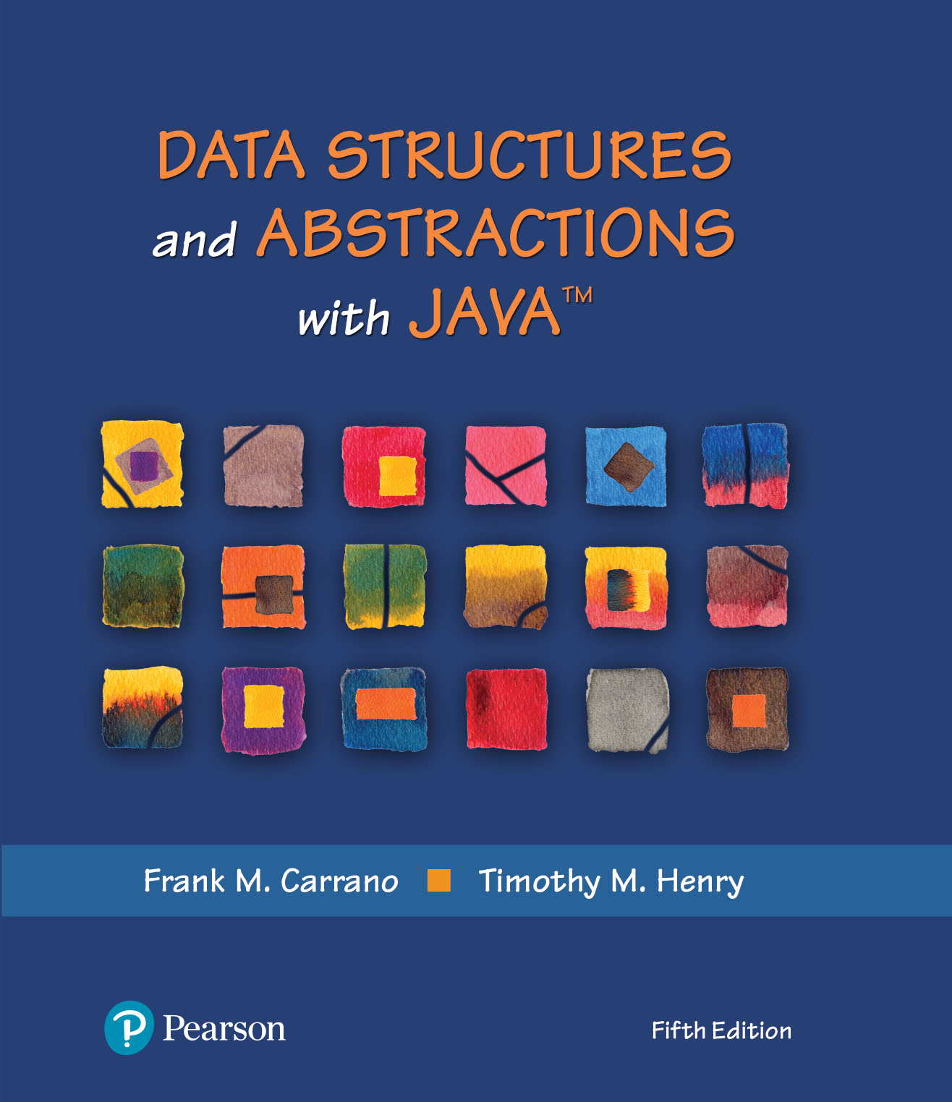
Module 7
Stacks & Stack Implementation

Slide 3
Video Notes
The ADT Stack
https://mediaplayer.pearsoncmg.com/assets/secs-vn-ch05a-the-adt-stack
Using the ADT Stack
https://mediaplayer.pearsoncmg.com/assets/secs-vn-ch04a-measuring-efficiency
Class LinkedStack
https://mediaplayer.pearsoncmg.com/assets/secs-vn-ch06a-the-class-linked-stack
Class ArrayStack
https://mediaplayer.pearsoncmg.com/assets/secs-vn-ch06b-the-class-array-stack
Notes:
To maximize your learning experience, watch videos prior to attending class each week
We will look at two implementations, array based and linked, for each ADT

Slide 4
Additional Videos
Infix to Postfix conversions example
https://www.youtube.com/watch?v=MxKBRgyO-94&ab_channel=Education4u
Data Structures | Introduction | Lec-1 | Bhanu Priya
https://www.youtube.com/watch?v=coxWfcz_sIk&list=PLrjkTql3jnm8ikiQIeIHrMYCaBfkBkfYR
https://www.youtube.com/watch?v=coxWfcz_sIk&list=RDCMUCKS34cSMNaXaySe2xgXH-3A&start_radio=1&t=162
Notes:
To maximize your learning experience, watch videos prior to attending class each week
We will look at two implementations, array based and linked, for each ADT

Slide 5
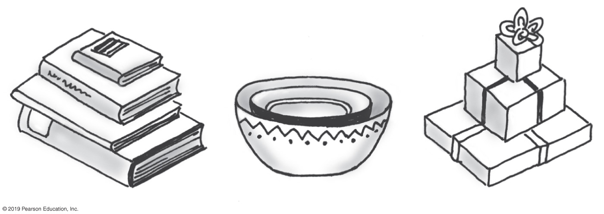
Stacks
Add item on top of stack
Remove item that is topmost
Last In, First Out … LIFO
Notes:
A stack is a data structure

Slide 6
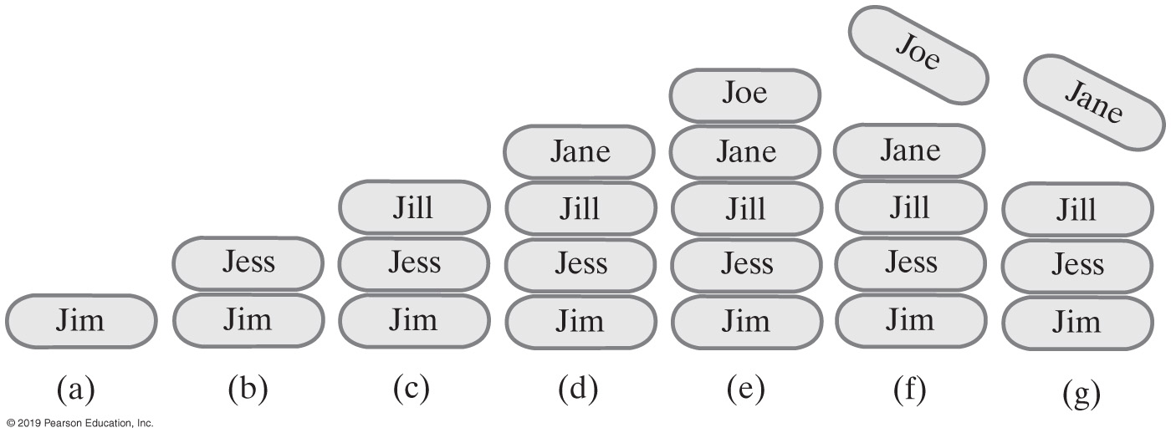
Stack Example
Stack<String> stringStack = new Stack<>();
(a) stringStack.push(“Jim”);
(b) stringStack.push("Jess");
(c) stringStack.push("Jill");
(d) stringStack.push("Jane");
(e) stringStack.push("Joe");
(f) stringStack.pop();
(g) stringStack.pop();
Notes:
For (b), we cannot remove Jim until we have removed Jess (first)
Stack is practical; used in many applications

Slide 7
ADT Stack | Operations
Pseudocode | UML | Description
push(newEntry) | +push(newEntry: T): void | Task: Adds a new entry to the top of the stack. Input: newEntry is the new entry. Output: None.
pop() | +pop(): T | Task: Removes and returns the stack’s top entry. Input: None. Output: Returns the stack’s top entry. Throws an exception if the stack is empty before the operation.
peek() | +peek(): T | Task: Retrieves the stack’s top entry without changing the stack in any way. Input: None. Output: Returns the stack’s top entry. Throws an exception if the stack is empty.
isEmpty() | +isEmpty(): boolean | Task: Detects whether the stack is empty. Input: None. Output: Returns true if the stack is empty.
clear() | +clear(): void | Task: Removes all entries from the stack. Input: None. Output: None.
Notes:
push and pop are the basic (critical) operations of a stack

Slide 8
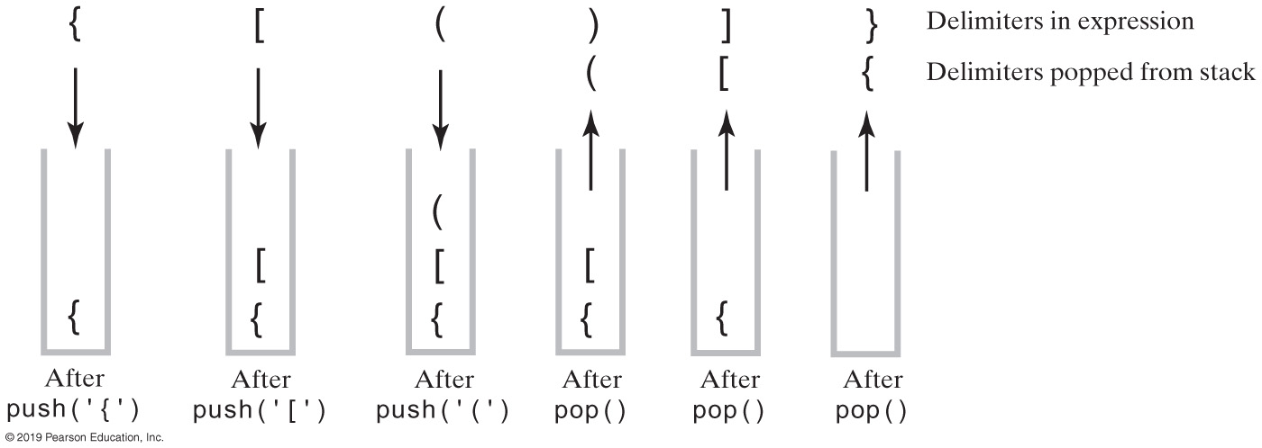
Example | Balanced Delimiters
The contents of a stack during the scan of an expression that contains balanced delimiters{ [ ( ) ] }
Notes:
Watch video
This is how your IDE checks for missing ()
Activity 3.1

Slide 9
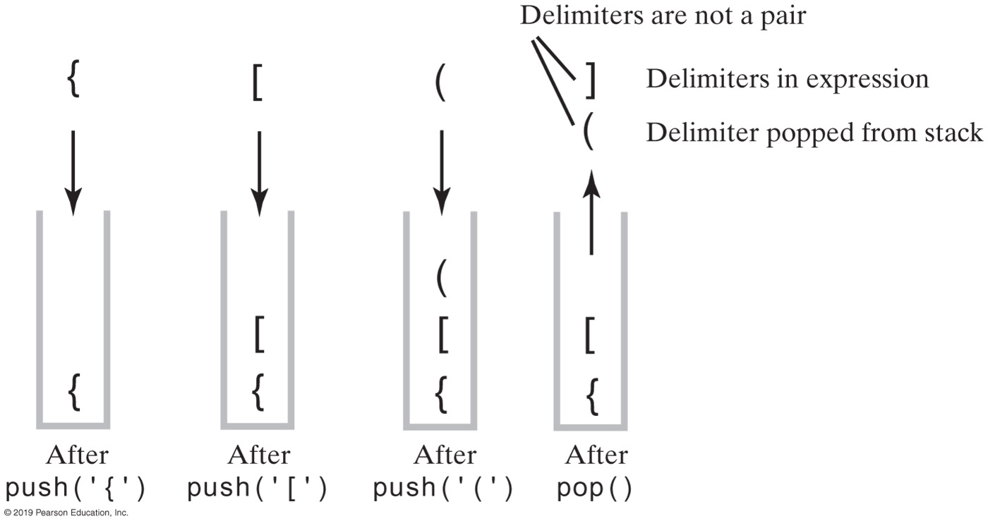
Expression | Unbalanced Delimiters
The contents of a stack during the scan of an expression that contains unbalanced delimiters { [ ( ] ) }

Slide 10
Processing Algebraic Expressions
Algorithm checkBalance(expression)
// Returns true if the parentheses, brackets, and braces in an expression are paired correctly.
isBalanced = true // The absence of delimiters is balanced
while ((isBalanced == true) and not at end of expression)
{
nextCharacter = next character in expression
switch (nextCharacter)
{
case '(': case '[': case '{':
Push nextCharacter onto stack
break
case ')': case ']': case '}':
if (stack is empty)
isBalanced = false
else
{
openDelimiter = top entry of stack
Pop stack
isBalanced = true or false according to whether openDelimiter and nextCharacter are a pair of delimiters
}
break
}
}
if (stack is not empty)
isBalanced = false
return isBalanced

Slide 11
Algebraic Expressions
Infix : a + b
each binary operator appears between its operands
a / b * (c + (d - e))
How do we process the above expression
Postfix: a b +
each binary operator appears after its operands
Prefix: + a b
each binary operator appears before its operands
We need to write code to evaluate expressions!
Notes:
a = 2, b = 4, a + b = ?
Infix vs. Postfix

Slide 12
Infix-to-postfix Conversion (Rule)
To convert an infix expression to postfix form, you take the following actions, according to the symbols you encounter, as you process the infix expression from left to right:
Operand | Append each operand to the end of the output expression.
Operator ^ | Push ^ onto the stack.
Operator +, -, *, or / | Pop operators from the stack, appending them to the output expression, until either the stack is empty or its top entry has a lower precedence than the newly encountered operator. Then push the new operator onto the stack.
Open parenthesis | Push ( onto the stack.
Close parenthesis | Pop operators from the stack and append them to the output expression until an open parenthesis is popped. Discard both parentheses.
Notes:
Operands: a, b
Operator: +

Slide 13
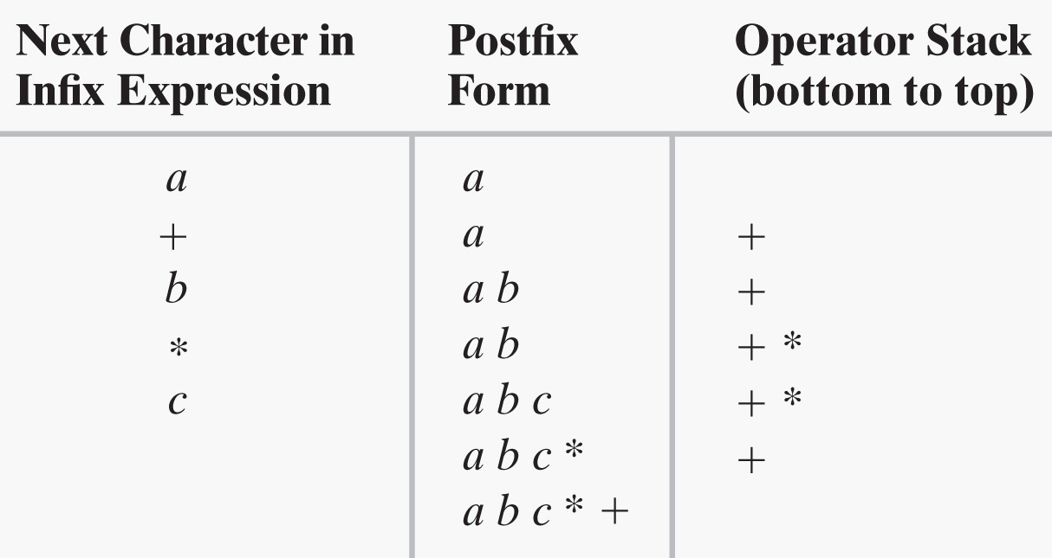
Converting Infix to Postfix (1 of 2)
a + b * c
What about ? a - b + c
Notes:
Stack contains operators
Build your postfix expression “on the fly”

Slide 14
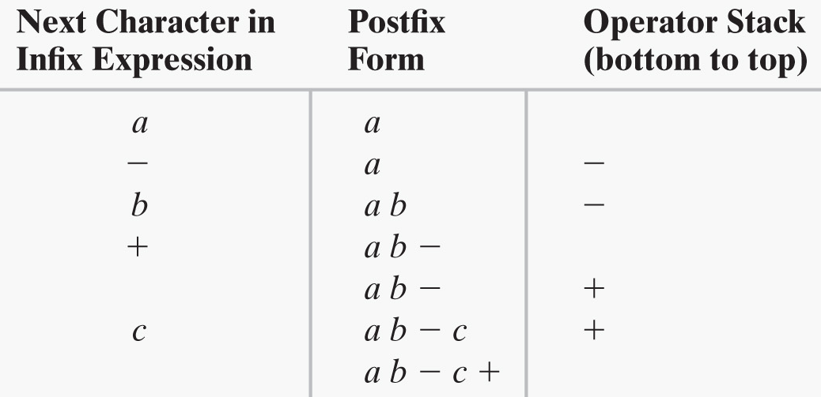
Converting Infix to Postfix (2 of 2)
a - b + c

Slide 15
Activity: Examples
A + B * C + D
(A + B) * (C + D)
A * B + C * D
A + B + C + D
x ^ y / (5 * z) + 10
Infix / Postfix Converter
https://www.mathblog.dk/tools/infix-postfix-converter/
Be able to do this by hand

Slide 16
Solutions | Previous Examples
Infix | Postfix
A + B * C + D | A B C * + D +
(A + B) * (C + D) | A B + C D + *
A * B + C * D | A B * C D * +
A + B + C + D
What about?
a / b * (c + (d - e))
Notes:
Notice the postfix expressions

Slide 17
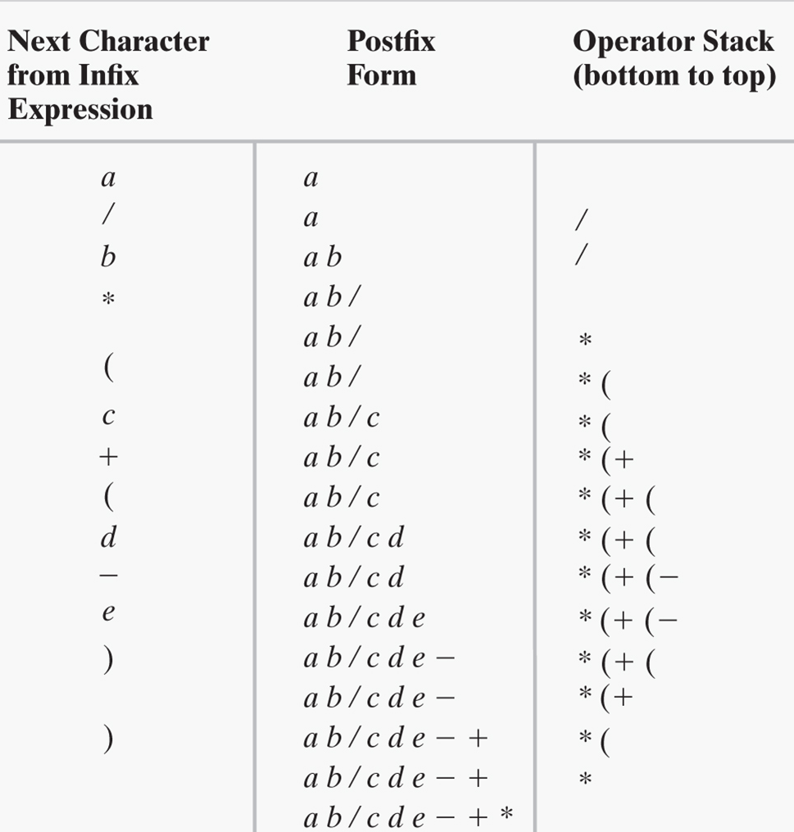
Learning Activity
a / b * (c + (d - e))

Slide 18
Infix-to-postfix Algorithm (1 of 2)
Algorithm convertToPostfix(infix)
// Converts an infix expression to an equivalent postfix expression.
operatorStack = a new empty stack
postfix = a new empty string
while (infix has characters left to parse)
{
nextCharacter = next nonblank character of infix
switch (nextCharacter)
{
case variable:
Append nextCharacter to postfix
break
case '^' :
operatorStack.push(nextCharacter)
break
case '+' : case '-' : case '*' : case '/' :
while (!operatorStack.isEmpty() and
precedence of nextCharacter <= precedence of operatorStack.peek())
{
Append operatorStack.peek() to postfix
operatorStack.pop()
}
operatorStack.push(nextCharacter)
break

Slide 19
Infix-to-postfix Algorithm (2 of 2)
case '( ' :
operatorStack.push(nextCharacter)
break
case ')' : // Stack is not empty if infix expression is valid
topOperator = operatorStack.pop()
while (topOperator != '(')
{
Append topOperator to postfix
topOperator = operatorStack.pop()
}
break
default:
break // Ignore unexpected characters
}
}
while (!operatorStack.isEmpty())
{
topOperator = operatorStack.pop()
Append topOperator to postfix
}
return postfix

Slide 20
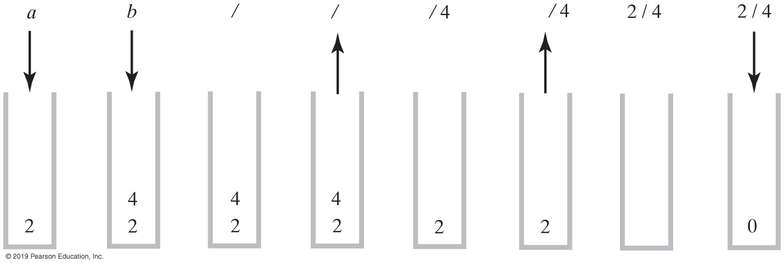
Expression | Postfix Evaluation
Evaluation of the postfix expression a b / where a is 2 and b is 4
Notes:
Notice how we pop operands: (1) to the right of the operator, then (2) to the left

Slide 21
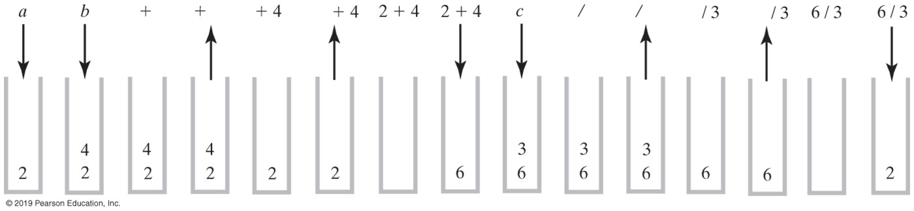
Postfix Evaluation
Evaluation of the postfix expression a b + c / where a = 2, b = 4, c = 3

Slide 22
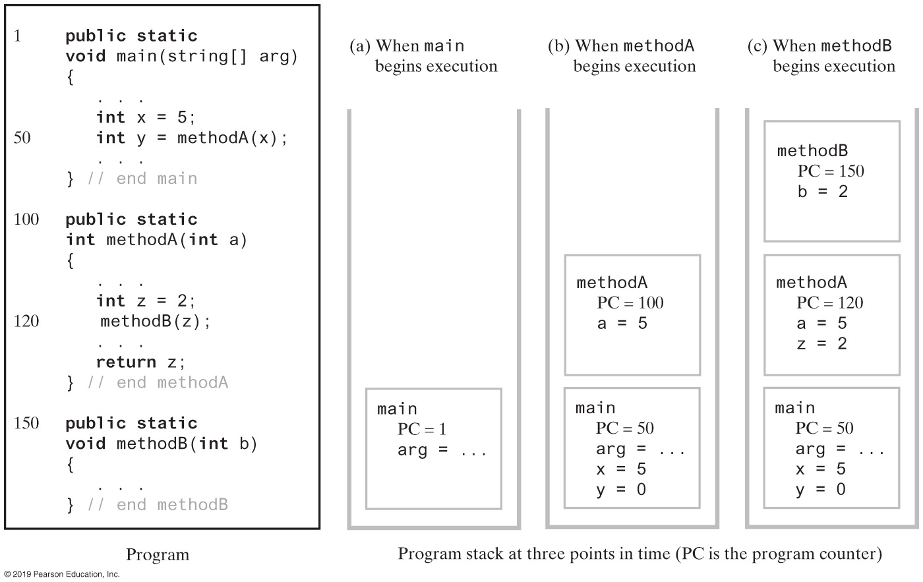
Application | Program Stack
Notes:
Characteristics of function calls

Slide 23
Class Stack<E>(Java Class Library)
Methods
A constructor – creates an empty stack
public T push(T item);
public T pop();
public T peek();
public boolean empty();
https://docs.oracle.com/en/java/javase/11/docs/api/java.base/java/util/Stack.html
We are learning what a Stack is and how to use it
Notes:
The Stack is readily available
Available in java.util

Slide 24
Stack (Queue) | Restricted Structure(s)
Two of the most commonly used restricted structures
Ideally suited for a good number of applications
Operation restrictions
Update is not supported
Insert is supported (but restricted)
Fetch and Delete are combined into one operation
Restricting basic operations & access modes of standard ADT
Arithmetic vs. ADT operations
24
Notes:
insert, delete, update, get

Slide 25
Restrictions (Restricted Structures)
Restrictions on Node Number Access Mode
Can’t say “Fetch-and-Delete the 3rd node”
Can only say “Fetch-and-Delete”
For a Queue: the node returned and deleted is the node in the structure the longest time
For a Stack: the node returned and deleted is the node in the structure the shortest time
Access mode restrictions
Key field mode is not supported
Node number mode is severely restricted
A priority queue is a restricted structure used in scheduling applications
25
Notes:
We will learn how to implement a priority queue later
https://docs.oracle.com/en/java/javase/11/docs/api/java.base/java/util/Queue.html

Slide 26
ADT Stack | Interface
/** An interface for the ADT stack. */
public interface StackInterface<T>
{
/** Adds a new entry to the top of this stack.
@param newEntry An object to be added to the stack. */
public void push(T newEntry);
/** Removes and returns this stack's top entry.
@return The object at the top of the stack.
@throws EmptyStackException if the stack is empty before the operation. */
public T pop();
/** Retrieves this stack's top entry.
@return The object at the top of the stack.
@throws EmptyStackException if the stack is empty. */
public T peek();
/** Detects whether this stack is empty.
@return True if the stack is empty. */
public boolean isEmpty();
/** Removes all entries from this stack. */
public void clear();
} // end StackInterface

Slide 27
Module 7B
Implementations

Slide 28
Design Decision
How should we handle the situation when stack is full?
When it’s empty?
What to do with pop and peek?
Possible actions
Assume that the ADT is not empty
Return null (why null?)
Throw user defined exception, EmptyStackException
Prefer throwing exceptions instead of returning values to signal problem
Avoid ambiguous return values

Slide 29
Linked Implementation
Each operation involves top of stack
push
pop
peek
Head of linked list easiest, fastest to access
Let this be the top of the stack

Slide 30
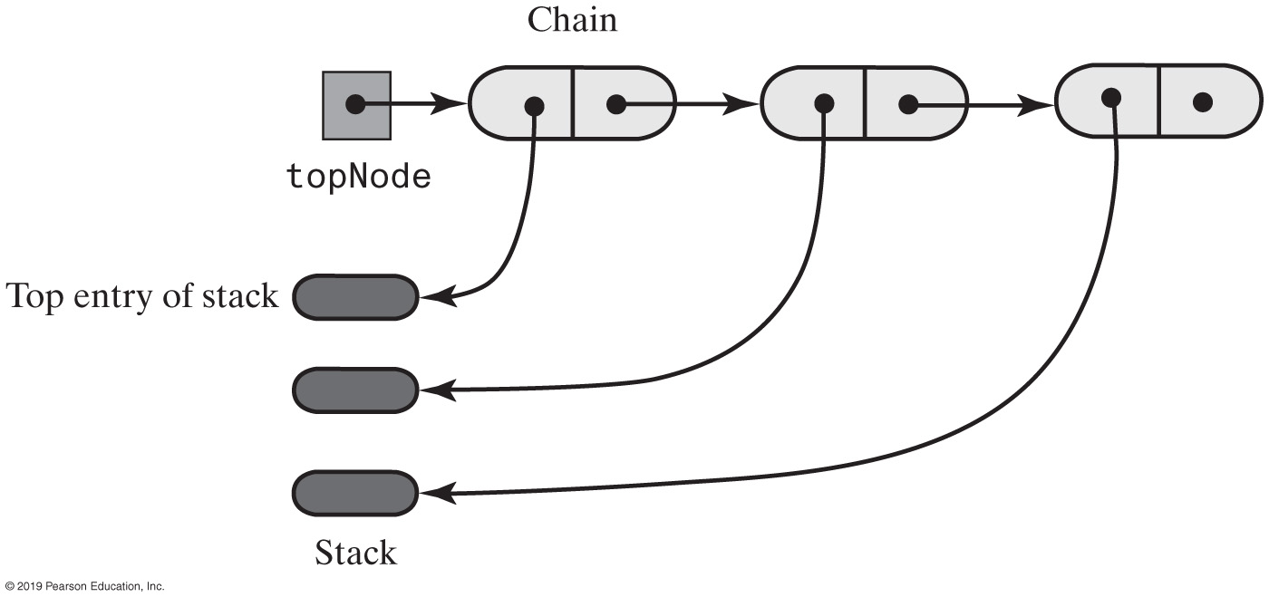
Linked Implementation
1st node is the top of the stack
Notes:
1st node is the top of the stack

Slide 31
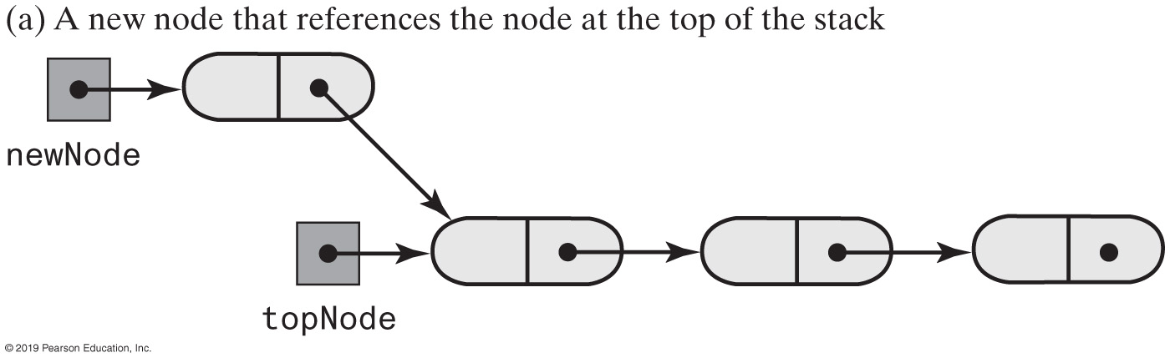
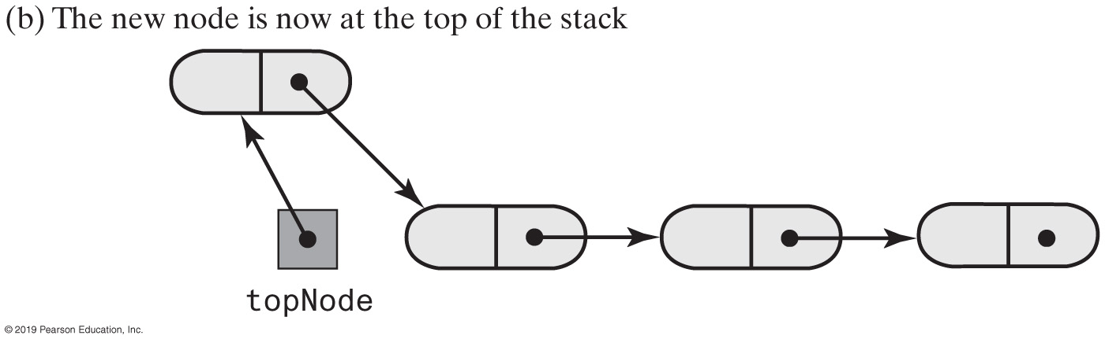
Stack | Push
Notes:
We know how to do this; just like adding a new node to a linked chain

Slide 32
Stack | Linked Implementation
/** A class of stacks whose entries are stored in a chain of nodes. */
public final class LinkedStack<T> implements StackInterface<T>
{
private Node topNode; // References the first node in the chain
public LinkedStack()
{
topNode = null;
} // end default constructor
// < Implementations of the stack operations go here. >
// . . .
private class Node
{
private T data; // Entry in stack
private Node next; // Link to next node
// < Implementations of the node operations go here. >
} // end Node
} // end LinkedStack

Slide 33
Stack | Linked Implementation
public void push(T newEntry)
{
Node newNode = new Node(newEntry, topNode);
topNode = newNode;
} // end push

Slide 34
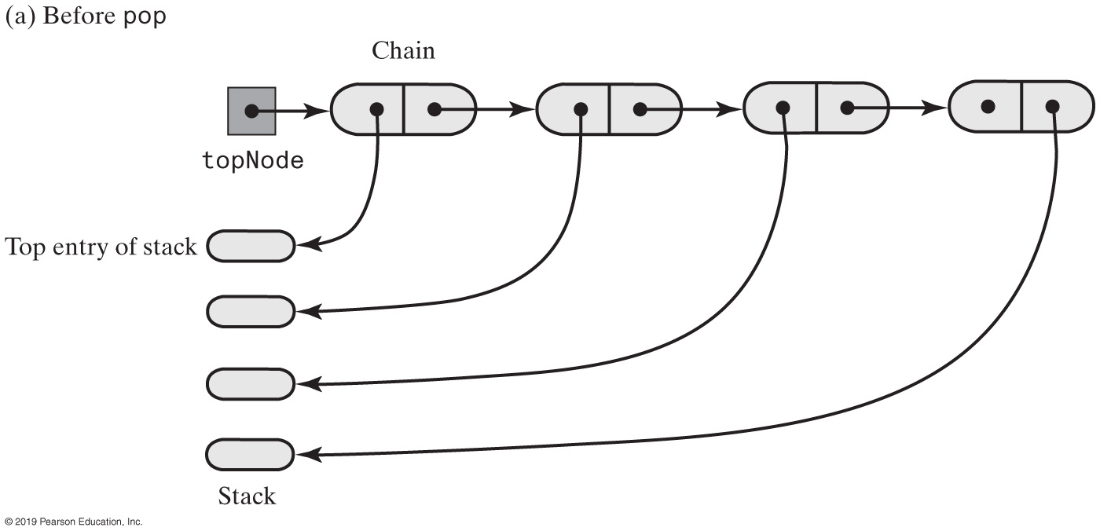
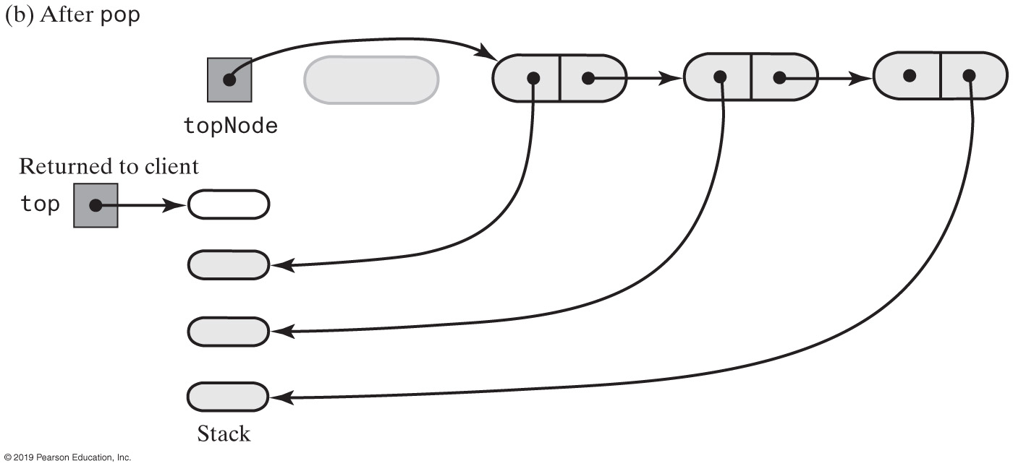
Stack | Pop
Notes:
Just like delete a node

Slide 35
Linked Implementation
public T peek()
{
if (isEmpty())
throw new EmptyStackException();
else
return topNode.getData();
} // end peek
public T pop()
{
T top = peek(); // Might throw EmptyStackException
// Assertion: topNode != null
topNode = topNode.getNextNode();
return top;
} // end pop

Slide 36
Stack | Array-Based Implementation
Same set of operations
push
pop
peek
Each operation involves top of stack
End of the array easiest to access
Let this be top of stack
Let first entry be bottom of stack

Slide 37
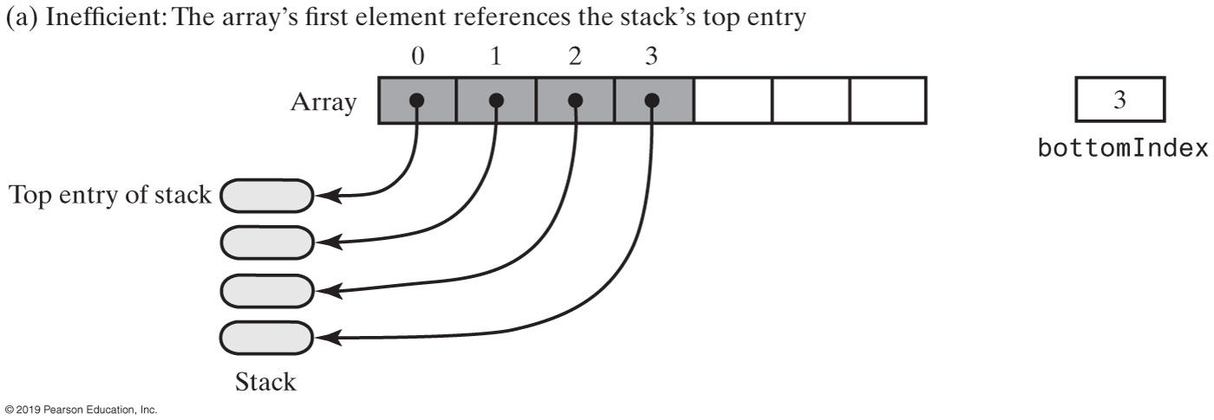
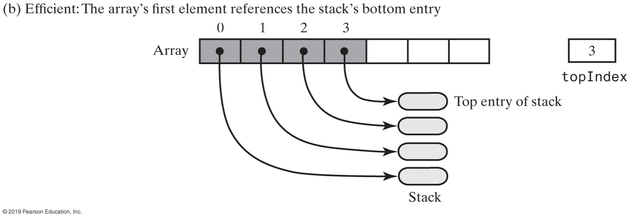
Stack | Array-Based
Array representations of a stack
Notes:
(b) is better; we have an “position” index already

Slide 38
Stack | Array-Based
/** A class of stacks whose entries are stored in an array. */
public final class ArrayStack<T> implements StackInterface<T>
{
private T[] stack; // Array of stack entries
private int topIndex; // Index of top entry
private boolean integrityOK = false;
private static final int DEFAULT_CAPACITY = 50;
private static final int MAX_CAPACITY = 10000;
public ArrayStack()
{
this(DEFAULT_CAPACITY);
} // end default constructor
public ArrayStack(int initialCapacity)
{
integrityOK = false;
checkCapacity(initialCapacity);
// The cast is safe because the new array contains null entries
@SuppressWarnings("unchecked")
T[] tempStack = (T[])new Object[initialCapacity];
stack = tempStack;
topIndex = -1;
integrityOK = true;
} // end constructor
// < Implementations of the stack operations go here. >
// . . .
} // end ArrayStack

Slide 39
Stack | Array-Based
public void push(T newEntry)
{
checkInyegrity();
ensureCapacity();
stack[topIndex + 1] = newEntry;
topIndex++;
} // end push
private void ensureCapacity()
{
if (topIndex >= stack.length - 1) // If array is full, double its size
{
int newLength = 2 * stack.length;
checkCapacity(newLength);
stack = Arrays.copyOf(stack, newLength);
} // end if
} // end ensureCapacity

Slide 40
Stack | Array-Based
public T peek()
{
checkIntegrity();
if (isEmpty())
throw new EmptyStackException();
else
return stack[topIndex];
} // end peek
public T pop()
{
checkIntegrity();
if (isEmpty())
throw new EmptyStackException();
else
{
T top = stack[topIndex];
stack[topIndex] = null;
topIndex--;
return top;
} // end if
} // end pop

Slide 41
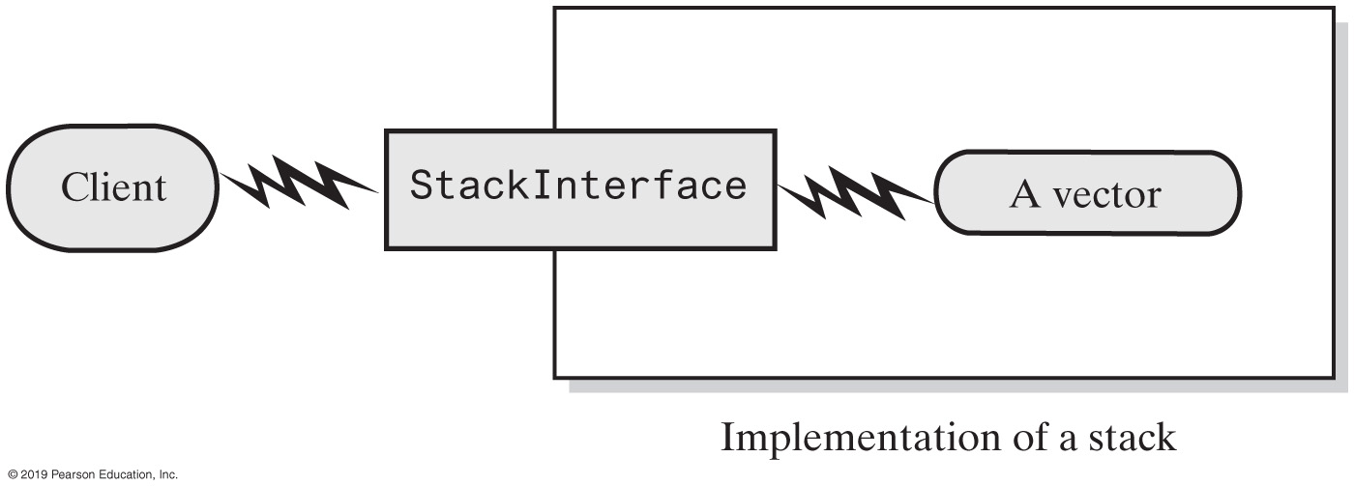
Stack | Vector-Based Implementation
A client using the methods given in StackInterface; these methods interact with a vector’s methods to perform stack operations
Notes:
A stack can be built independently to how it’s being built

